Slide 1

Galatians 2:1-21
Many resources are used and I claim no originality. Scripture taken from the New King James Version®. Copyright © 1982 by Thomas Nelson unless otherwise noted.

Slide 2
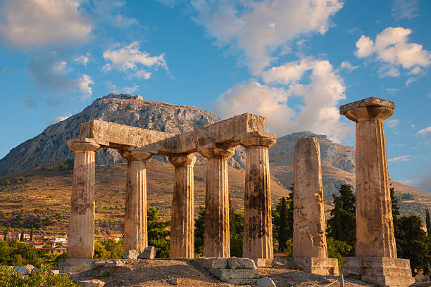
Galatians 2:1-5 NKJV
1 Then after fourteen years I went up again to Jerusalem with Barnabas, and also took Titus with me. 2 And I went up by revelation, and communicated to them that gospel which I preach among the Gentiles, but privately to those who were of reputation, lest by any means I might run, or had run, in vain. 3 Yet not even Titus who was with me, being a Greek, was compelled to be circumcised. 4 And this occurred because of false brethren secretly brought in (who came in by stealth to spy out our liberty which we have in Christ Jesus, that they might bring us into bondage), 5 to whom we did not yield submission even for an hour, that the truth of the gospel might continue with you.

Slide 3
Galatians 2:6-10 NKJV
6 But from those who seemed to be something—whatever they were, it makes no difference to me; God shows personal favoritism to no man—for those who seemed to be something added nothing to me. 7 But on the contrary, when they saw that the gospel for the uncircumcised had been committed to me, as the gospel for the circumcised was to Peter 8 (for He who worked effectively in Peter for the apostleship to the circumcised also worked effectively in me toward the Gentiles), 9 and when James, Cephas, and John, who seemed to be pillars, perceived the grace that had been given to me, they gave me and Barnabas the right hand of fellowship, that we should go to the Gentiles and they to the circumcised. 10 They desired only that we should remember the poor, the very thing which I also was eager to do.

Slide 4
Galatians 2:11-15 NKJV
11 Now when Peter had come to Antioch, I withstood him to his face, because he was to be blamed; 12 for before certain men came from James, he would eat with the Gentiles; but when they came, he withdrew and separated himself, fearing]those who were of the circumcision. 13 And the rest of the Jews also played the hypocrite with him, so that even Barnabas was carried away with their hypocrisy. 14 But when I saw that they were not straightforward about the truth of the gospel, I said to Peter before them all, “If you, being a Jew, live in the manner of Gentiles and not as the Jews,]why do you compel Gentiles to live as Jews? 15 We who are Jews by nature, and not sinners of the Gentiles,

Slide 5
Galatians 2:16-21 NKJV
16 knowing that a man is not justified by the works of the law but by faith in Jesus Christ, even we have believed in Christ Jesus, that we might be justified by faith in Christ and not by the works of the law; for by the works of the law no flesh shall be justified. 17 “But if, while we seek to be justified by Christ, we ourselves also are found sinners, is Christ therefore a minister of sin? Certainly not! 18 For if I build again those things which I destroyed, I make myself a transgressor. 19 For I through the law died to the law that I might live to God. 20 I have been crucified with Christ; it is no longer I who live, but Christ lives in me; and the life which I now live in the flesh I live by faith in the Son of God, who loved me and gave Himself for me. 21 I do not set aside the grace of God; for if righteousness comes through the law, then Christ died in vain.”
dikaioō

Slide 6
We are saved by grace alone, through faith alone, in Christ alone.

Slide 7
Galatians 2:16 NKJV
16 knowing that a man is not justified by the works of the law but by faith in Jesus Christ, even we have believed in Christ Jesus, that we might be justified by faith in Christ and not by the works of the law; for by the works of the law no flesh shall be justified.
Justified - Greek: dikaioō
“put right with, justify, vindicate, declare righteous”
Made Righteous by God through faith in Jesus Christ

Slide 8
Galatians 2:11-12 NKJV
11 Now when Peter had come to Antioch, I withstood him to his face, because he was to be blamed; 12 for before certain men came from James, he would eat with the Gentiles; but when they came, he withdrew and separated himself, fearing]those who were of the circumcision.
Galatians 2:11-12 NLT
11 But when Peter came to Antioch, I had to oppose him to his face, for what he did was very wrong. 12 When he first arrived, he ate with the Gentile believers, who were not circumcised. But afterward, when some friends of James came, Peter wouldn’t eat with the Gentiles anymore. He was afraid of criticism from these people who insisted on the necessity of circumcision.

Slide 9
ACTS 10 – PETER WITNESSES THE GENTILE’S SALVATION
FIRST: PETER TO REALIZE THERE IS NO MORE DIETARY LAWS.
SECOND: PETER WAS LED TO THE HOME OF A ROMAN SOLDIER.
THIRD: PETER ENTER THE HOME OF A ROMAN SOLDIER.
FOUTH: PETER WITNESSES THE OUTPOURING OF THE HOLY SPIRIT ON THE GENTILE FAMILY.

Slide 10
Galatians 2:13-16 NKJV
13 And the rest of the Jews also played the hypocrite with him, so that even Barnabas was carried away with their hypocrisy. 14 But when I saw that they were not straightforward about the truth of the gospel, I said to Peter before them all, “If you, being a Jew, live in the manner of Gentiles and not as the Jews,]why do you compel Gentiles to live as Jews? 15 We who are Jews by nature, and not sinners of the Gentiles, 16 knowing that a man is not justified by the works of the law but by faith in Jesus Christ, even we have believed in Christ Jesus, that we might be justified by faith in Christ and not by the works of the law; for by the works of the law no flesh shall be justified.

Slide 11
Romans 14:13 NKJV
Therefore, let us not judge one another anymore, but rather resolve this, not to put a stumbling block or a cause to fall in our brother’s way.
1 Corinthians 8:13 NKJV
Therefore, if food makes my brother stumble, I will never again eat meat, lest I make my brother stumble.

Slide 12
Romans 1:16-17 NKJV
16 For I am not ashamed of the gospel of Christ, for it is the power of God to salvation for everyone who believes, for the Jew first and also for the Greek. 17 For in it the righteousness of God is revealed from faith to faith; as it is written, “The just shall live by faith.”
1 Timothy 1:8-9 NKJV
8 Therefore do not be ashamed of the testimony of our Lord, nor of me His prisoner, but share with me in the sufferings for the gospel according to the power of God, 9 who has saved us and called us with a holy calling, not according to our works, but according to His own purpose and grace which was given to us in Christ Jesus before time began,

Slide 13
Matthew 10:32-33 NKJV
32 “Therefore, whoever confesses Me before men, him I will also confess before My Father who is in heaven. 33 But whoever denies Me before men, him I will also deny before My Father who is in heaven.

Slide 14
GALATIANS 2
FREEDOM IN CHRIST
4 TAKE AWAYS
BE CONSISTENT
FOLLOW JESUS’ EXAMPLE
EXPECT NOT EVERYONE WILL LIKE YOU
PRAY FOR BOLDNESS

Slide 15
God loves You and has a purpose for you.
Three questions that never change, but the answers do.
Who am I?
Who is God in my life?
What am I to do in the years I have left?

