Slide 1
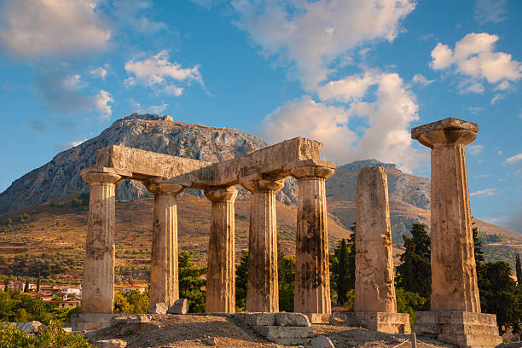
2 Corinthians 7
Many resources are used and claim no originality. Scripture taken from the New King James Version®. Copyright © 1982 by Thomas Nelson unless otherwise noted.

Slide 2
2 CORINTHIANS 7:1-6 NKJV
1 Therefore, having these promises, beloved, let us cleanse ourselves from all filthiness of the flesh and spirit, perfecting holiness in the fear of God. 2 Open your hearts to us. We have wronged no one, we have corrupted no one, we have cheated no one. 3 I do not say this to condemn; for I have said before that you are in our hearts, to die together and to live together. 4 Great is my boldness of speech toward you, great is my boasting on your behalf. I am filled with comfort. I am exceedingly joyful in all our tribulation. 5 For indeed, when we came to Macedonia, our bodies had no rest, but we were troubled on every side. Outside were conflicts, inside were fears. 6 Nevertheless God, who comforts the downcast, comforted us by the coming of Titus,

Slide 3
2 CORINTHIANS 7:7-10 NKJV
7 and not only by his coming, but also by the consolation with which he was comforted in you, when he told us of your earnest desire, your mourning, your zeal for me, so that I rejoiced even more. 8 For even if I made you sorry with my letter, I do not regret it; though I did regret it. For I perceive that the same epistle made you sorry, though only for a while. 9 Now I rejoice, not that you were made sorry, but that your sorrow led to repentance. For you were made sorry in a godly manner, that you might suffer loss from us in nothing. 10 For godly sorrow produces repentance leading to salvation, not to be regretted; but the sorrow of the world produces death.

Slide 4
2 CORINTHIANS 7:11-14 NKJV
11 For observe this very thing, that you sorrowed in a godly manner: What diligence it produced in you, what clearing of yourselves, what indignation, what fear, what vehement desire, what zeal, what vindication! In all things you proved yourselves to be clear in this matter. 12 Therefore, although I wrote to you, I did not do it for the sake of him who had done the wrong, nor for the sake of him who suffered wrong, but that our care for you in the sight of God might appear to you. 13 Therefore we have been comforted in your comfort. And we rejoiced exceedingly more for the joy of Titus, because his spirit has been refreshed by you all. 14 For if in anything I have boasted to him about you, I am not ashamed. But as we spoke all things to you in truth, even so our boasting to Titus was found true.

Slide 5
2 CORINTHIANS 7:15-16 NKJV
15 And his affections are greater for you as he remembers the obedience of you all, how with fear and trembling you received him. 16 Therefore I rejoice that I have confidence in you in everything.

Slide 6
2 CORINTHIANS 7:5 NKJV
5 For indeed, when we came to Macedonia, our bodies had no rest, but we were troubled on every side. Outside were conflicts, inside were fears.

Slide 7
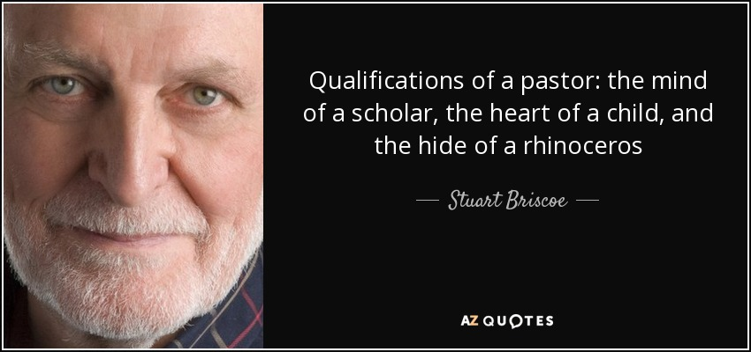

Slide 8
ORDINARY PEOPLE DOING EXTRA-ORDINARY ASSIGNMENTS
OUTSIDE CONFLICTS

Slide 9
2 CORINTHIANS 7:5 NKJV
5 For indeed, when we came to Macedonia, our bodies had no rest, but we were troubled on every side. Outside were conflicts, inside were fears.

Slide 10
2 CORINTHIANS 11:23-28 ESV
23 … with far greater labors, far more imprisonments, with countless beatings, and often near death. 24 Five times I received at the hands of the Jews the forty lashes less one. 25 Three times I was beaten with rods. Once I was stoned. Three times I was shipwrecked; a night and a day I was adrift at sea; 26 on frequent journeys, in danger from rivers, danger from robbers, danger from my own people, danger from Gentiles, danger in the city, danger in the wilderness, danger at sea, danger from false brothers; 27 in toil and hardship, through many a sleepless night, in hunger and thirst, often without food, in cold and exposure. 28 And, apart from other things, there is the daily pressure on me of my anxiety for all the churches.

Slide 11
ROMANS 12:17-21 NKJV
17 Repay no one evil for evil. Have regard for good things in the sight of all men.
18 If it is possible, as much as depends on you, live peaceably with all men.
19 Beloved, do not avenge yourselves, but rather give place to wrath; for it is written, “Vengeance is Mine, I will repay,” says the Lord.
20 Therefore,
“If your enemy is hungry, feed him;
If he is thirsty, give him a drink;
For in so doing you will heap coals of fire on his head.”
21 Do not be overcome by evil, but overcome evil with good.

Slide 12
1 PETER 3:9 NKJV
9 not returning evil for evil or reviling for reviling, but on the contrary blessing, knowing that you were called to this, that you may inherit a blessing.
10 For
“He who would love life, And see good days,
Let him refrain his tongue from evil, And his lips from speaking deceit.
11 Let him turn away from evil and do good; Let him seek peace and pursue it.
12 For the eyes of the Lord are on the righteous, And His ears are open to their prayers; But the face of the Lord is against those who do evil.”

Slide 13
ORDINARY PEOPLE DOING EXTRA-ORDINARY ASSIGNMENTS
OUTSIDE CONFLICTS
INSIDE FEARS

Slide 14
2 CORINTHIANS 7:5 NKJV
5 For indeed, when we came to Macedonia, our bodies had no rest, but we were troubled on every side. Outside were conflicts, inside were fears.

Slide 15
ORDINARY PEOPLE DOING EXTRA-ORDINARY ASSIGNMENTS
OUTSIDE CONFLICTS
INSIDE FEARS
GODLY COMFORTS

Slide 16
2 CORINTHIANS 7:5-7 NKJV
5 For indeed, when we came to Macedonia, our bodies had no rest, but we were troubled on every side. Outside were conflicts, inside were fears. 6 Nevertheless God, who comforts the downcast, comforted us by the coming of Titus, 7 and not only by his coming, but also by the consolation with which he was comforted in you, when he told us of your earnest desire, your mourning, your zeal for me, so that I rejoiced even more.

Slide 17
ORDINARY PEOPLE DOING EXTRA-ORDINARY ASSIGNMENTS
3 TAKEAWAYS
1. OUTSIDE CONFLICTS – do not expect everyone to like you being a Christian and your message of hope through faith in Jesus Christ.
2. INSIDE FEARS – keep your faith and trust in Jesus, and His Will to be done.
3. GODLY COMFORTS - be a Titus to someone this week.

Slide 18
SALVATION PRAYER
Lord Jesus, I confess my sins and ask for your forgiveness. Please come into my heart as my Lord and Savior. Take complete control of my life and help me to walk in Your footsteps daily by the power of the Holy Spirit. Thank you Lord, for saving me and for answering my prayer.
In Jesus’ name. Amen.

